Slide 2
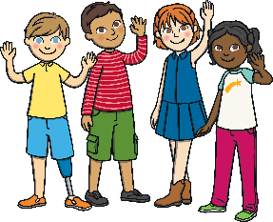
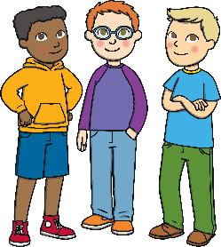
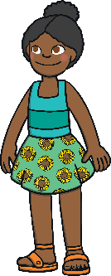
Strangers
Sometimes, I go out with my class.
When we go out, there are strangers. A stranger is someone I don’t know.
Some strangers might be nice.
Some strangers might not be nice.

Slide 3
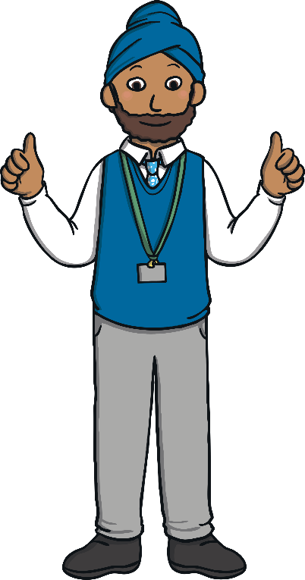
What Should I Do?
I will only talk to strangers if my teacher says it is OK.
I will talk to all
of the strangers I meet.

Slide 4
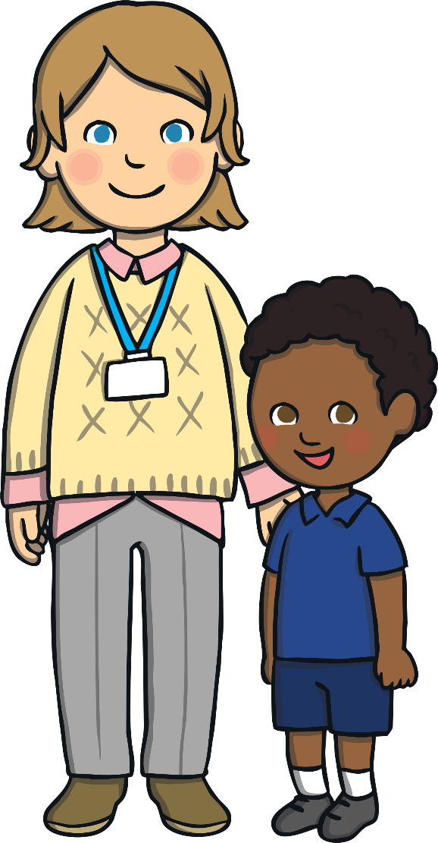
Well Done! Great Choice!
I will only talk to strangers if my teacher says
it is OK.
I will never take sweets from a stranger.
I will never take toys from a stranger.
I will never go anywhere with a stranger.
I will always tell my teacher about strangers.
When we go out, I will listen to my teacher and
stay with my class.

Slide 5
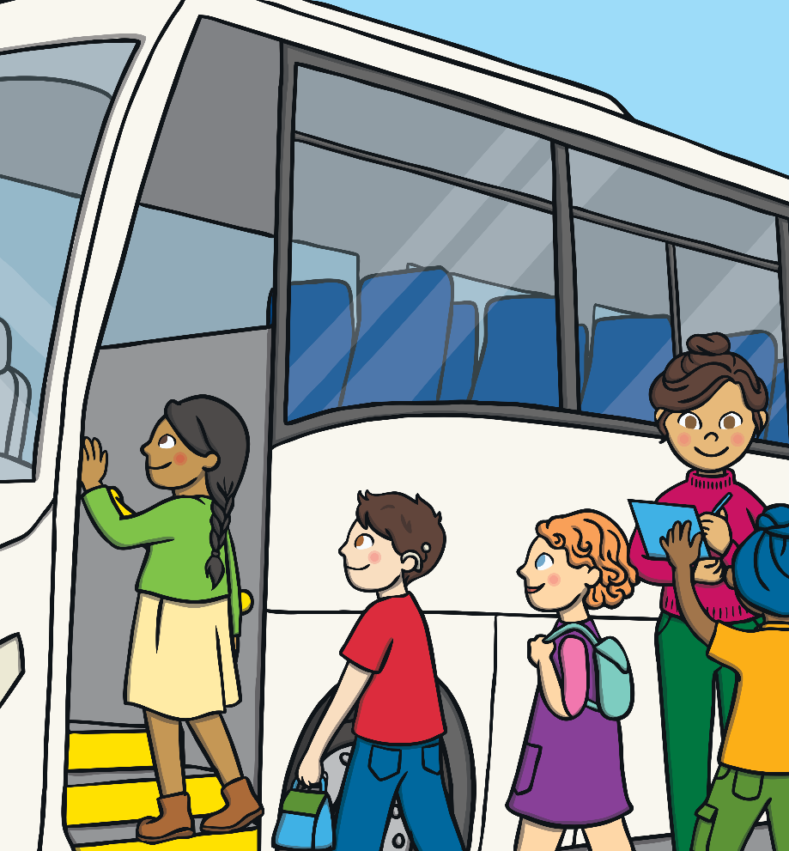
Hmmm... Let’s Think About What Happens If We Talk to Strangers
A stranger is someone we
don’t know.
A stranger might not be a very
nice person.
It is important not to talk to
strangers unless our teacher says
it is OK.
Our teacher wants to keep us safe.
We should stay near the teacher
when we are away from the school.

Slide 6
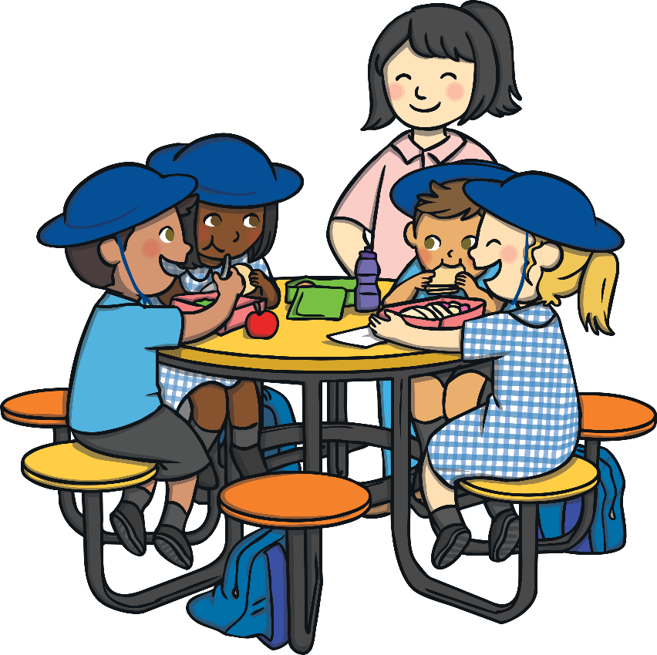
Strangers
I will try to remember not to talk to strangers.
When we go out, I will listen to my teacher.
I will stay with my class.
My teacher will help me with this.

