Slide 1
Welcome to Ingoldisthorpe C of E VA Primary School SEN information report
To best use this presentation please hit the small button on the bottom right-hand side of the window; it will take over your full screen and you can navigate using the arrow keys or swiping left and right. There are also links to get you to the correct information and return to the contents page.

Slide 2
WELCOME TO INGOLDISTHORPE PRIMARY SCHOOLS SEN REPORT
At Ingoldisthorpe C of E VA Primary School we have thought carefully and worked with our pupils, staff and governors to create a shared vision that reflects our values. We came together September 2018 to explore and write our vision. With the help of our local incumbent we chose the following bible passage to root our vision in biblical teachings: The Parables of the Prodigal Son
“Celebrate and be glad… he was lost and is found.” Luke 15:11-32
We are a family school where everyone matters. At the heart of our vision is a strong, positive influence on the high quality teaching, excellent staff and pupil relationships and well-being. All pupils are valued as individuals and thrive in their personal development. We focus on communication with children and adults to encourage the very best education for all of our learners. We value all children and adults, thinking carefully about their diversity of children’s backgrounds, interests, experience, knowledge and skills, so that all pupils regardless of individual need make the best possible progress. We are also highly motivated to upskill and train our own staff to increase the learning and specialist training within our setting. We have a high proportion of our children reaching all national standards, focus on a plan, do review cycle for SEND children to ensure rigorous assessment and monitoring for all. Our school’s link with the local church and parish is very strong and pupils and parents acknowledge this partnership as a distinctive feature of the school.

Slide 3
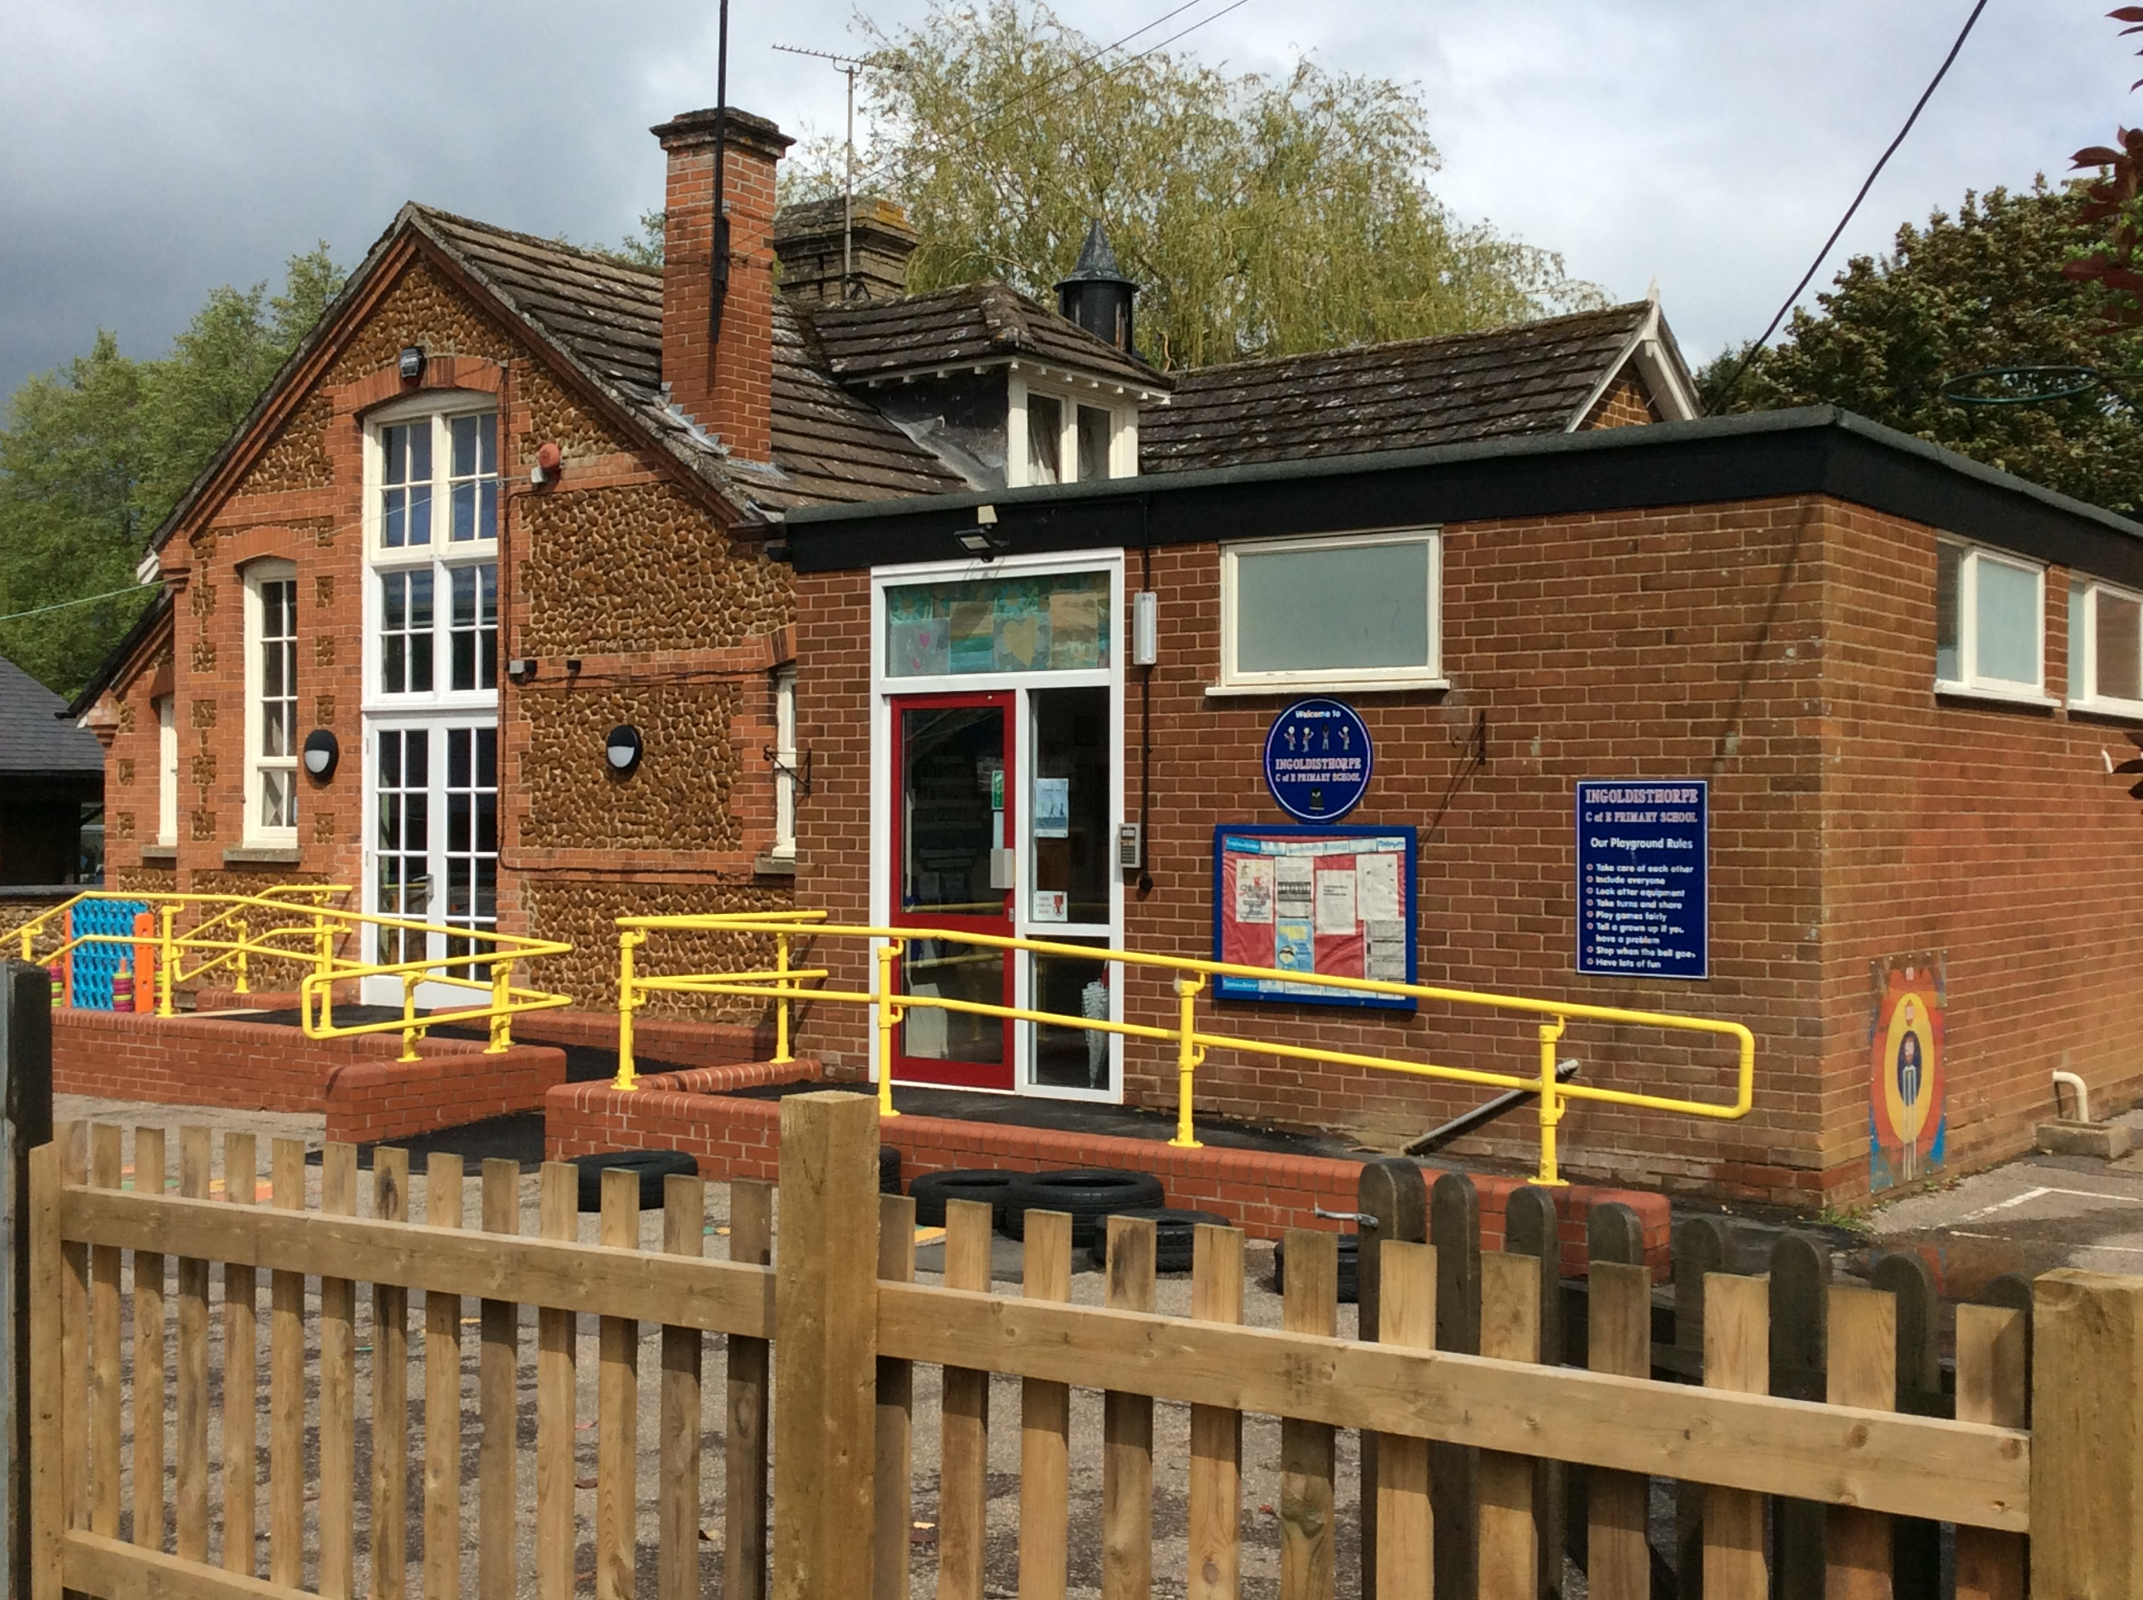
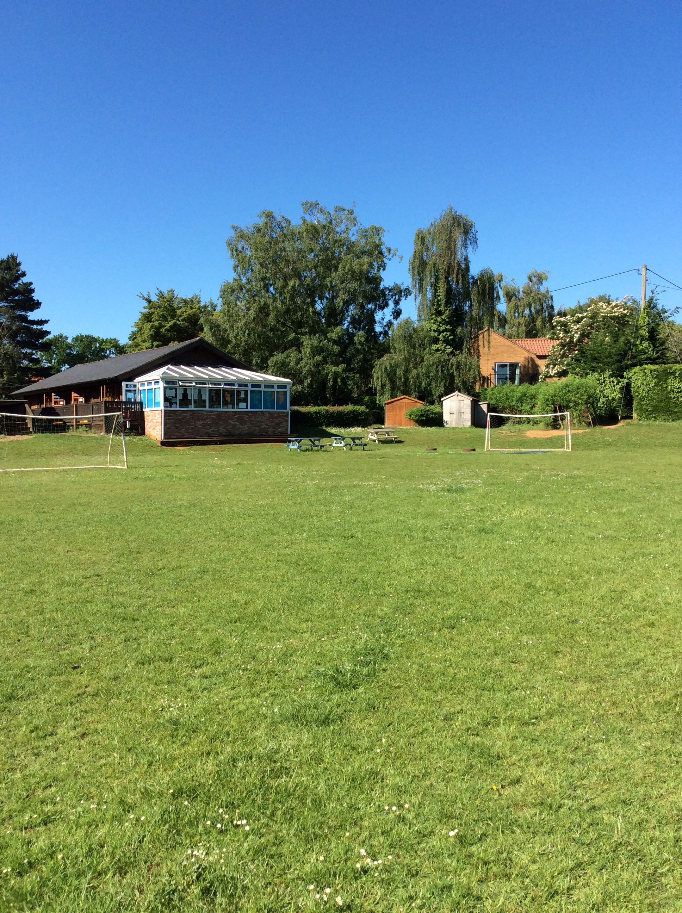
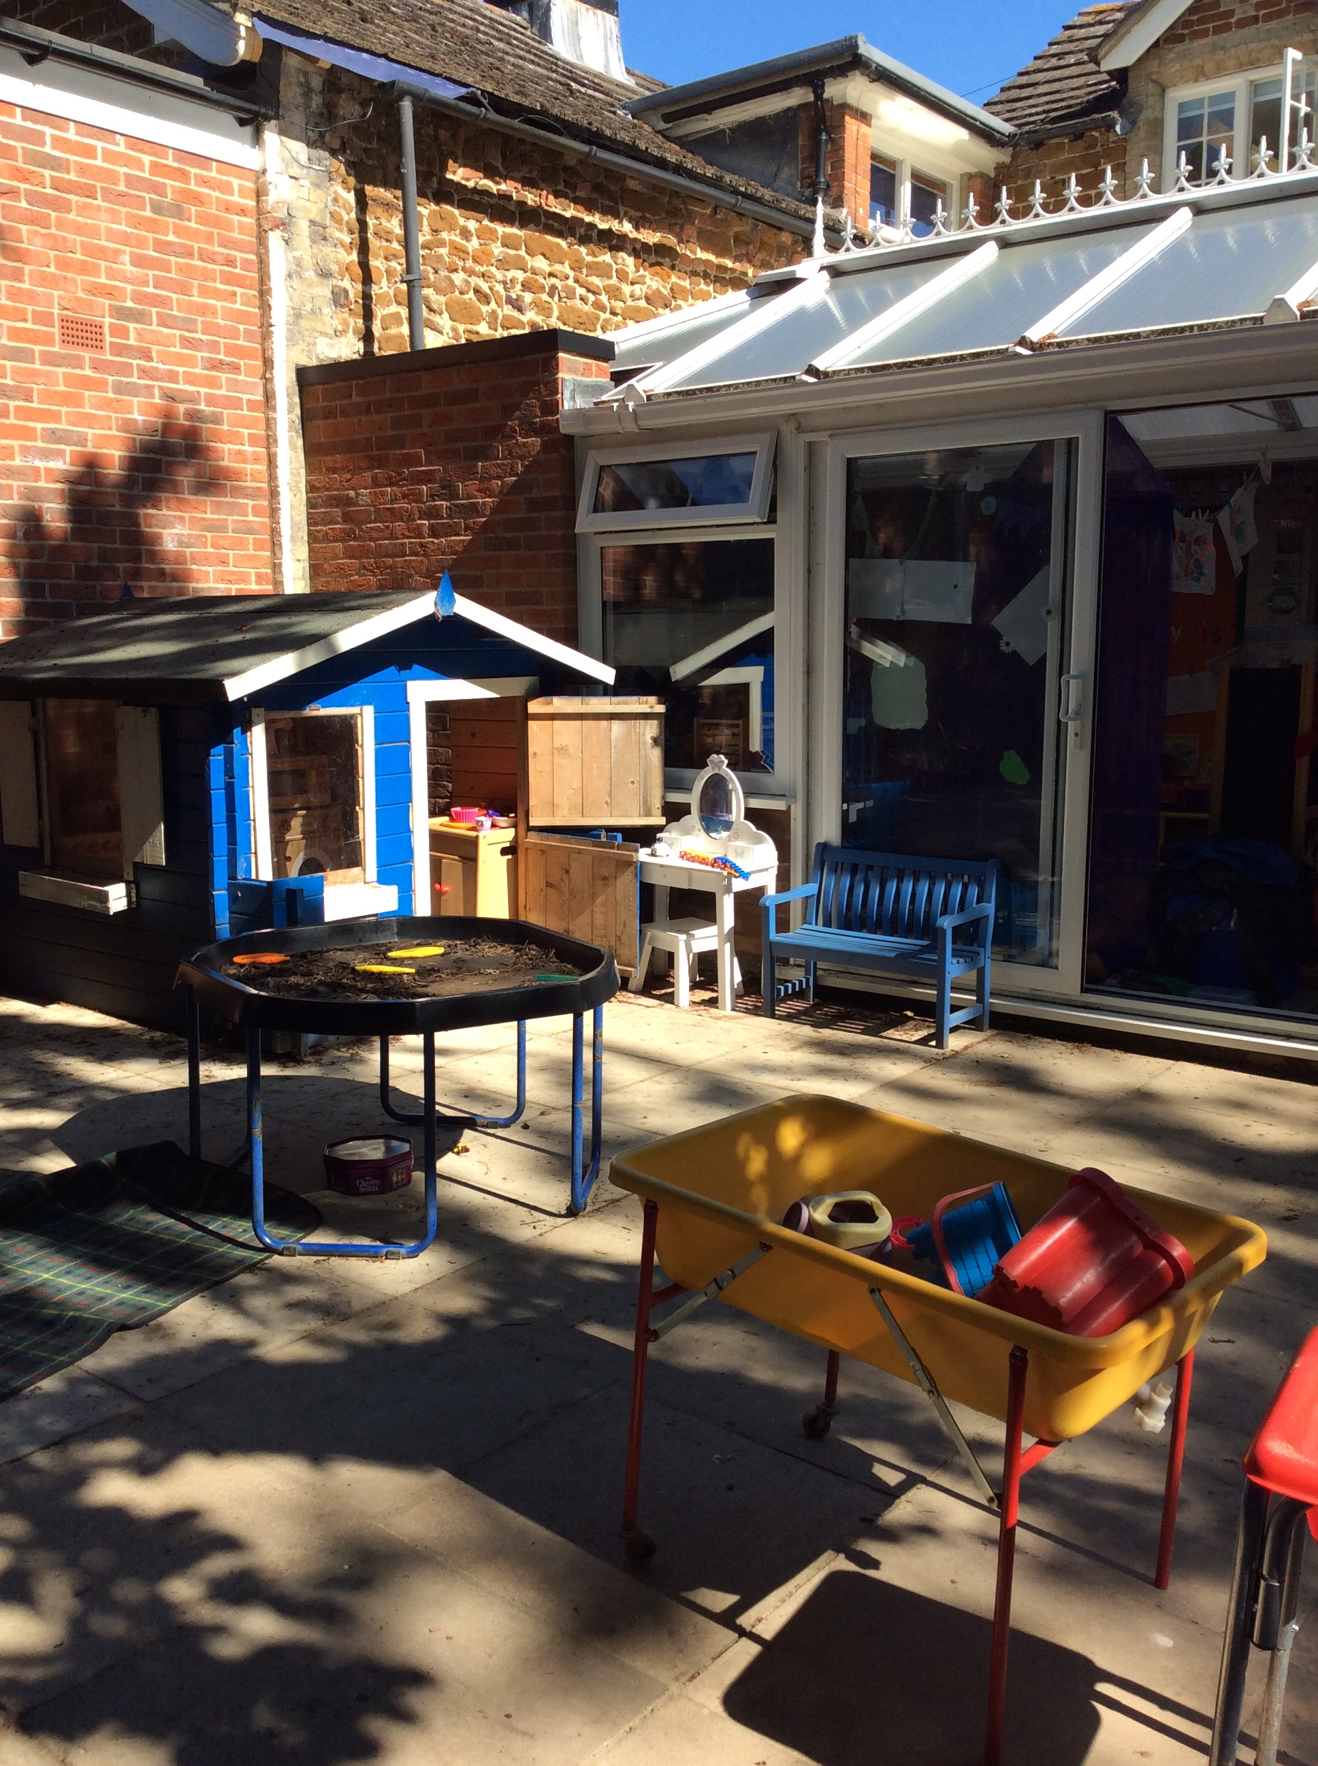
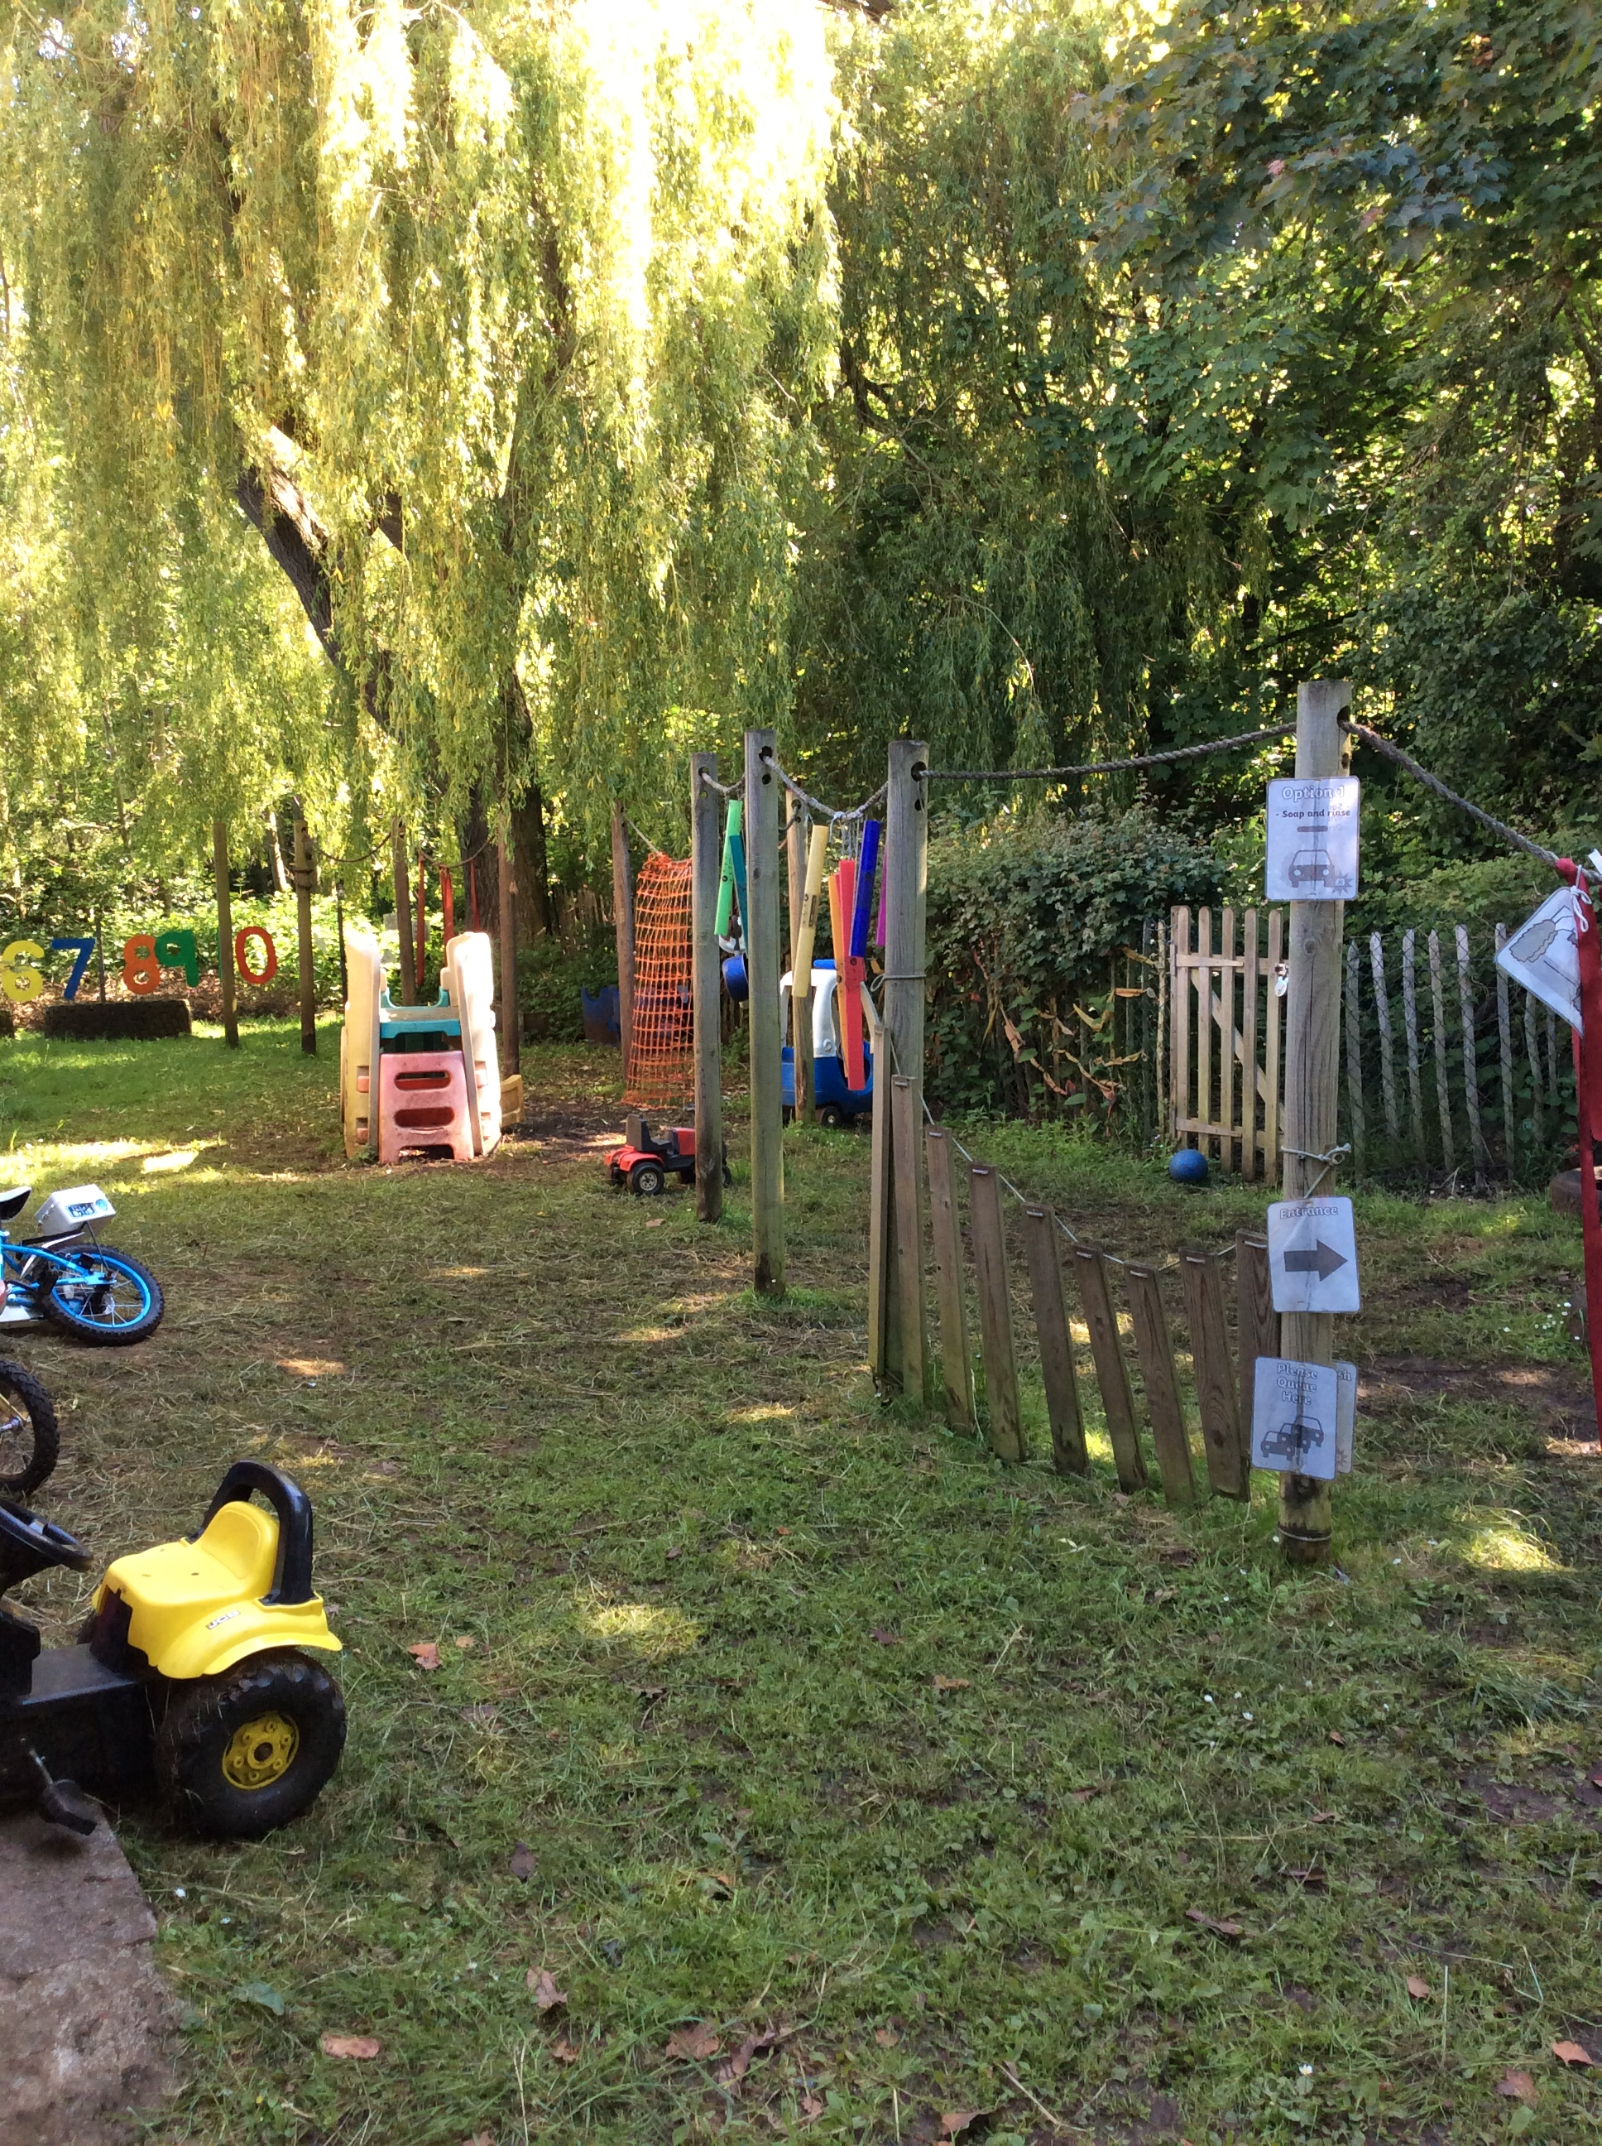
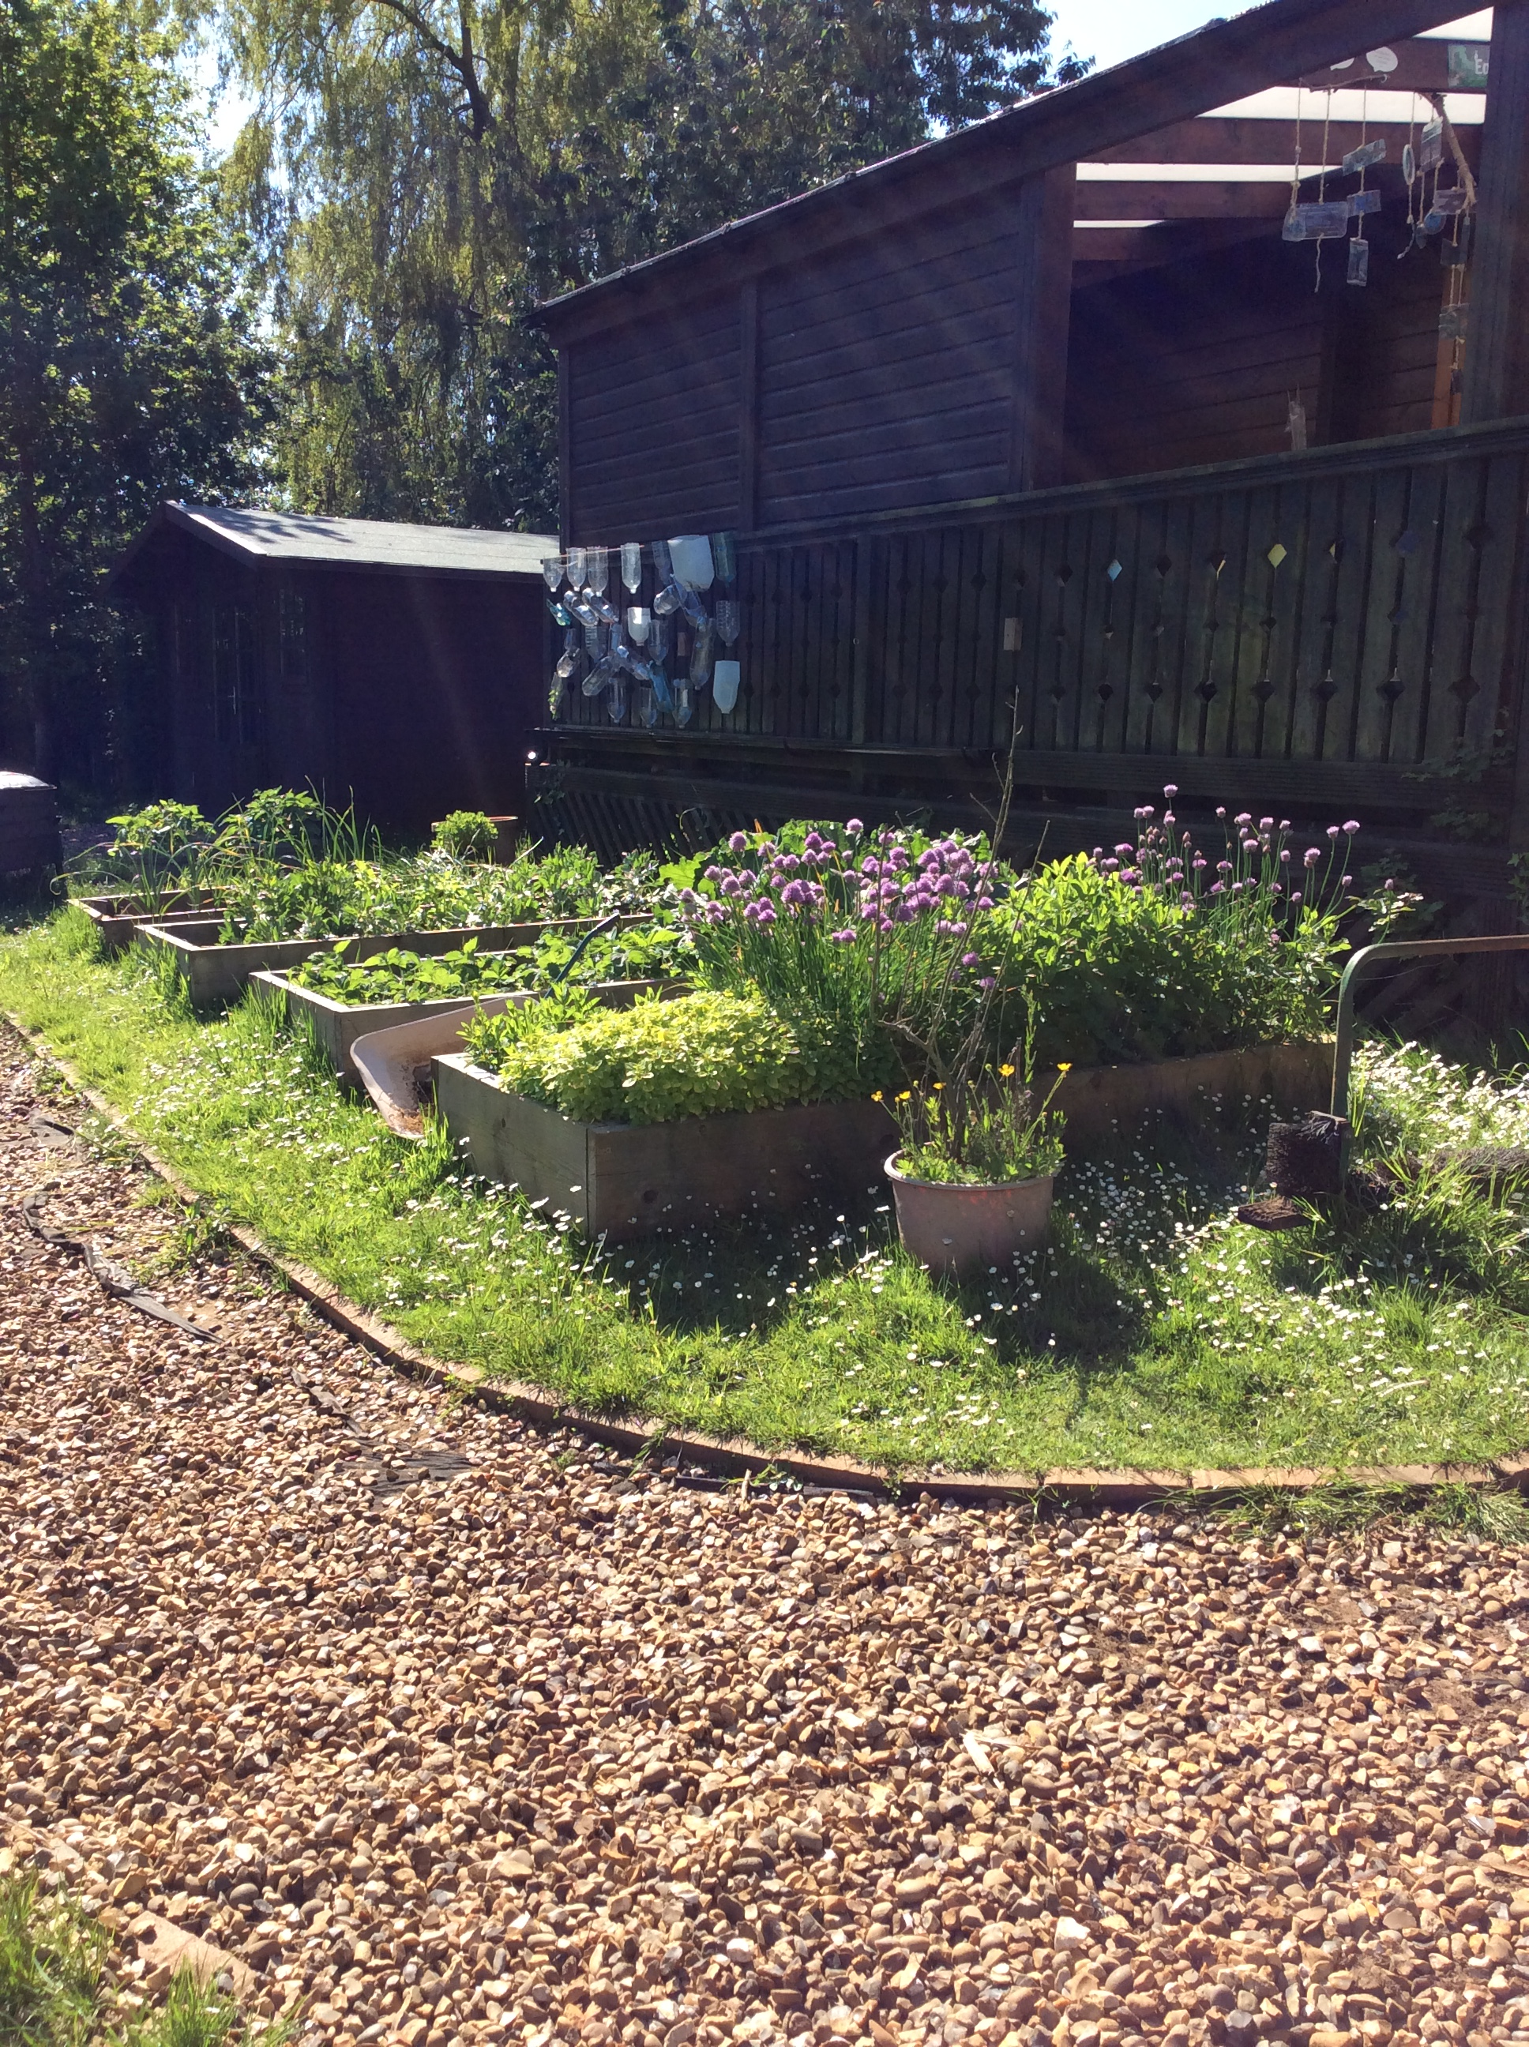
As part of the Children and Families Act 2013, Local Authorities are required to publish a Local Offer which sets out support that is available for children and young people with special educational needs (SEN) in the local area. The local offer tells parents how to access services in their area and what to expect from these services. Alongside this, schools are required to publish a SEN For more information about local offer go to the local offer page. In response to this, we have put together our SEN Information Report for Ingoldisthorpe C of E VA Primary. The information within describes the arrangements we make that are ‘additional and ‘extra’ for pupils with SEND.

Slide 4
CONTENTS PAGE PART 1
Admissions to our school
Accessibility of our school
Types of special needs
LAC children Pupil Premium
Procedure for identification (step by step)
What happens after we identify the children?
Waves of interventions at Ingoldisthorpe
Assess, Plan, Do, Review cycle
Interventions for children with SEND
Cognition and learning needs
Social and emotional needs
Communication and interaction needs
Sensory and physical needs

Slide 5
Admissions and school places
CONTENTS
Pupils of all abilities, needs and disabilities are admitted to our school with a warm welcome to our “family school where everyone matters.”
Admission arrangements for pupils with SEND are governed by the Local Authority Admissions Policy
For more information about admissions go to
https://www.norfolk.gov.uk/education-and-learning/schools/school-admissions
Alternatively, read our school policy
https://ingoldisthorpeprimary.com/admissions

Slide 6
Accessibility
CONTENTS
Our school is accessible for all children. As a school we are happy to discuss and adapt to individual needs.
Our grounds and facilities include: −
All entrances into school are ground level or ramped for ease of access
Large adapted toilets
Wide doors without steps in most classrooms
Easy access to outdoor classrooms via walkways and slopes.
Microphones and amplifiers (where needed)
Great acoustics in our log cabin classrooms
Staff partially trained in sign language (BSL and Makaton)
A bank of laptops, use of Dictaphones and iPads
Dyslexia friendly off-white-coloured whiteboards in all classrooms
We also tailor our bespoke, topic related curriculum to meet the needs of our learners.; adapting resources, topics and activities to support and engage all of our learners.
We pride ourselves on well thought out and planned trips to include all learners regardless of specialist need, this includes residentials and whole school trips.

Slide 7
Looked after children (LAC) and Pupil premium (PP)
CONTENTS
Children who are looked after by the Local Authority are provided with prioritised care from our experienced and trained staff. Staff make communication a priority with carers of LAC.
Teachers and the SENDCo attend regular LAC meetings with social workers, carers, parents, family support workers and the children. At these meetings we explain the children’s achievements, monitor their progress and discuss how we can best meet their needs.
The children are invited to express their wishes and feelings in these meetings and during additional sessions (where needed) with a designated adult. Many of our LAC children access Thrive sessions with our trained Thrive instructor.
We understand that for some looked after children who have an SEND, they may need significant pastoral input as well as differentiated educational provision in order to ensure academic and emotional progress.
We have an excellent record of working alongside the local authority, social workers and the Welfare call team to ensure the best outcomes for our looked after children, as our school is a “family school where everyone matters.”
Pupil premium is extra funding allocated to the school for children who are eligible for FSM (free school meals), LAC (looked after children) or those from families in the forces. Funding is issued to schools to enable PP children to further their aspirations and enable them in a full curriculum including trips, extra curricular clubs, visits and residentials. All PP children will have access to financial support, free school meals, interventions and extra curricular activities depending on their need, progress and interests.
For more information and to read the Pupil Premium Impact Report click here or go to https://www.ingoldisthorpeprimary.com/pupil-premium

Slide 8
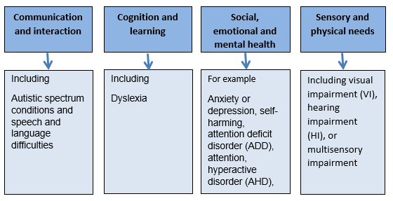
Types of SEND
Our SEND data 20/21
CONTENTS
Special Educational Needs that affect a child’s ability can include:
Behaviour
Difficulties socialising
Reading and writing difficulties
Difficulty with understanding
Physical needs or impairments
Low concentration levels
Speech and language delay
Medical needs
Emotional difficulties
Anxiety/ depression
Processing difficulties
Autism and diagnosed difficulties
Along with many others.

Slide 9
Procedure of Identification
CONTENTS
Initial concern raised
Class teacher gathers information and assessments for the child (possibly from previous schools or providers)
Teaching is differentiated in each lesson to adapt to the children’s needs and progress is monitored
Reviews and discussions in staff meetings to monitor children with SEND or concerns
Class teacher monitors progress over a few weeks and child added to monitoring list
If more support is required, teacher will discuss next steps with SENDCo
Parents meeting to discuss difficulties and next steps, with parental permission the child is placed on the SEN register.
Interventions put in place, reviewed, adapted (where needed) and continued for 6-12 weeks. Reviewed every term.
Progress is monitored and reviewed with regular parent meetings with teacher and SENDCo (at least 3 times per year or termly)
Progress reports are compiled
If extra support is needed, referrals can be made to relevant external specialists. Advice will be given by the specialists. Team around the child (parents, carers, SENDCo, teachers, specialists) create specific targets to monitor and achieve over time. Reviewed termly.
Exceptional resource funding (ERF)
Additional funding can be sought from the cluster after an assessment from an external specialist, the funding will be sought from the ‘cluster’ and will need to be agreed by the ERF panel. All additional funding needs to exceed the expected spend for SEND and be closely monitored.

Slide 10
What happens after a child is identified with a SEND?
CONTENTS
Some of our pupils may require additional support so that they can access the curriculum and make progress at their own level They may have an SEND, if despite quality first teaching, they are still finding it difficult to maintain the pace of their peers or are failing to match their previous rates of progress. We aim to help them close any gaps in their learning by introducing adapted learning, interventions, programmes and support into their daily education.
If a learner is identified as having SEND, we will work closely with the pupil and their parents to provide provision that is ‘additional to or different from’ the normal differentiated curriculum, intended to overcome the barrier to their learning. At this point, with the support of the parents/carers, the child would be added to the schools SEN register.
Once a child has been identified, the teachers, parents and child will put together a plan of action to support and hopefully improve learning. The child, teachers and parents would set targets for the child’s progress, making sure they are manageable goals which can be measured, achieved and assessed at the next update meeting.
The interventions would be planned and assessed for a baseline and then continue for a minimum of 6 weeks.
After 6 weeks or a half term the interventions can be assessed for effectiveness and evaluated. This is called the assess, plan, do, review cycle which we follow in school to help all our learners.
Parents will be in communication with the teachers and updated of progress or difficulties along the way. Once the assessment of the interventions have taken place, a meeting can be held to discuss the next steps for the child. On many occasions, interventions continue to enable sustained progress to be made.
What is assess, plan, do, review?

Slide 11
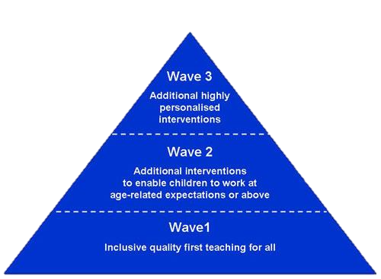
Waves of intervention
CONTENTS
Wave 3 > 1:1 individualised sessions
This type of intervention has a high impact level and is used to ensure high quality personalised learning to bridge the gap in learning and raise attainment.
Wave 2 > Small group work
This type of intervention involves small targeted sessions in small groups to help boost learning in a specific area. The children can be grouped in social groups, academic groups or in mixed ability depending on the activities.
Wave 1 > Quality first teaching
This type of intervention is completed in class, by the teacher and by differentiation and adaptations in the classroom.

Slide 12
Assess, Plan, Do, Review (APDR)
CONTENTS
The APDR cycle is widely used in schools during normal teaching. For children with SEND, the cycle is used more regularly to track their progress towards a common goal. The APDR cycle should be completed at school with the involvement of the child and parents.
Assess
Plan
Do
Review
Identify child’s strengths and weaknesses
Teacher assessments
Data on progress, achievement, attendance
Pupil voice and parent voice
Work samples may be gathered
Advice from external agencies (if involved)
Support and guidance from SENDCo
E.G: find the concern) Johnny is finding spelling tricky, can only achieve 1/10 each week and this is causing his writing to be difficult to read.
Reasonable adjustments to be made to classroom practise/ learning resources etc
Interventions discussed and decided upon
Decision on additional provision to be put in place/ time allowed for sessions
SMART achievable targets set and agreed
E.G: (create an action) Johnny will complete spelling shed every morning in school for 10 minutes. He will also complete 3 x 20 minutes per week of sound discovery with an adult.
Are the pupils on track/ making progress?
Has there been any improvement?
Pupil, parent and teacher voice
Is the pupil responding well to the plan? Data
Does there need to be a change or should plan continue?
E.G: The actions are discussed and whether Johnny has made progress. Data shows 1 level of progress in sound discovery and weekly scores of over 4 in his spellings. The decision is made to continue intervention for 1 more cycle and assess afterwards.
Monitoring of progress and session completed
Teacher to check in with named adults
Implementation of strategies and individual sessions
Time ring fenced for provision
E.G: (Complete the action) Johnny will need to complete the planned activities for a minimum of 6 weeks or half term with the teachers ensuring praise and regular time set aside for these sessions.

Slide 13
Interventions at Ingoldisthorpe
CONTENTS
At Ingoldisthorpe Primary we pride ourselves on our provisions, interventions and support for our SEND learners. We use a variety of interventions and programmes to help all children to overcome their barriers to learning and achieve.
We may use a variety of interventions including:
Cognition & Learning
In class support Read Write Inc Sound Discovery Maths Counts/ Recap sessions Booster sessions 1:1 reading comprehension Vocabulary Ninja Word/Number Shark
Sensory & Physical
Sensory Breaks Forest school outdoor learning Sand play Role play Soft play Sensory activities Yoga Big Blue Bubble Occupational therapy activities
Social & Emotional
Time to talk Thrive activities Thrive 1:1 sessions Social Speaking Show and tell in classes PSHE sessions Lego group time Big Blue Bubble Yoga and relaxation
Communication & Interaction
1-1 Speech and language sessions Speech and language assessment from ECCH Time to talk Peer time – Lego /art Nurture Groups School Council Captains/mentors
More info
More info
More info
More info

Slide 14
Cognition and learning needs
Cognition and learning refers to the thought process and thinking skills a child may have. Cognition and learning needs are on a continuum and may vary depending on the subject, time and the child. Children with learning needs may progress at a slower pace than their peers and need interventions like the ones below.
CONTENTS
All these strategies aim to improve academic achievement and progress related to learning and understanding. Some children will need top up and are able to make significant progress. If you wish to discuss any of these strategies, please contact your class teacher.
Wave 1: In class | Wave 2: Small group work | Wave 3: 1-1 sessions
Differentiated curriculum Specific groupings Personalised resources Booster club Labelled resources Maths resources for hands on learning Modelling Verbal feedback Homework specific to difficulty Personalised Learning Spelling shed work Questioning Reading/ Spelling/ tests Assessment data Seating Plans Tackling Tables daily and weekly tests Visual aids & resources Visual timetable Dyslexia friendly classes Writing frames Support from peers Vocabulary ninja | Booster groups/ clubs Maths catch up Maths pre teach Number shark Word shark Spelling shed Hive games G&T booster sessions Guided Groups Memory Groups Multi-sensory Numicon Nurture Group Paired work/peer mentoring Sound Discovery Assessments | 1-1 programmes 1-1 teaching – phonics, reading, maths, writing Building resilience work Additional test time Additional access arrangements Access through technology Catch up maths and literacy Coloured overlays, reading rulers and exercise books Differentiated homework Norfolk Assessment Pathways Pre-teaching & Over Learning SATs arrangements Reading comprehension work Scribes Educational psychologist advice SRB input

Slide 15
Social and emotional needs
Social and emotional needs refer to the emotional wellbeing and ability to manage, understand and deal with our emotions in a healthy way, in a variety of situations. In children, SEMH difficulties may manifest themselves in a variety of ways, children's mental health is a key priority and is a whole school focus at Ingoldisthorpe Primary.
CONTENTS
All these strategies aim to improve emotional understanding, regulation and social interactions. Some children will need regular contact with an adult in order to understand their emotions and how to cope with them. If you wish to discuss any of these strategies, please contact your class teacher.
Wave 1: In class | Wave 2: Small group | Wave 3: 1-1 sessions
PSHE/ RSE activities Outdoor learning Time in church Attendance stickers/ certificates Pupil of the day/ week Sharing assemblies Circle time Class rules Communication diary House/ table team points Parent Questionnaires Thrive/ rainbow room Playground Buddy benches Pupil Questionnaires School Council SEAL activities/ sessions Seating plans Traffic Lights Bronze, silver, gold awards KS1 Transition activities Use of TA Whole school family Yoga/ relaxation Breathing exercises Big blue bubble | Breaktime play groups Time to talk Lego groups Thrive group work Newsletter groups Cycling proficiency Eco Team Gardening groups In class TA support Librarians Monitors/ captains TA led sports/ activities outdoors Forest school group Nurture Group Year 6 leaders RE leaders Small group circle time Big blue bubble in groups Social speaking | Additional support for transition Behaviour Logs Breaktime TA Drawing and Talking Early Help Support Family Support Plans (FSPs) Nursing team Thrive sessions 1:1 Norfolk Steps Training Point 1 Reward charts Risk assessments Sensory Circuits SRB referral Work with Social Care Zones of Regulation WIN / PACE regulation Time to empty bucket Emotional release work

Slide 16
Communication and Interaction needs
Communication and interaction needs refers to children who struggle with speech and spoken language and also to those children who struggle to understand language. Children with SLCN will need regular monitoring and possibly specialist support from an SRB. However, at Ingoldisthorpe the EYFS practitioners and teachers are well trained to observe and help those with SLCN
CONTENTS
Wave 1: In class | Wave 2: Small group | Wave 3: 1-1 sessions
Peer work Partner chat Circle time/ SEAL sessions Differentiation -delivery, pace, outcome, questioning, grouping, homework Displays – visual – symbols Labelled resources with pictures Verbal feedback Processing Time Routines School Council meetings Seating plans Check in every morning Simplified language Use of TA Visual timetable Coloured whiteboards Writing frames Time to talk Speech and language sessions Forest schools | Class laptop/ iPad time. Clicker 8 In class TA support Memory work Pre-teaching Post lesson catch up Quiet space for Speech therapy exercises Reading Partners Small group work Speech and Language Group Nurture groups | Additional test time Access arrangements ASD support Access through technology Individualised timetables Individualised work spaces Visual timetable/organiser Norfolk Assessment Pathways Lego therapy/ group work TAs lunchtime support Speech and Language Therapist Clicker 8 Signing Social stories SRB input Time to talk Peer art Nurture groups 1:1 adult support Lunchtime support Assessments from ECCH Captains/ mentors
All these strategies aim to increase children’s ability to work with others, understand social interactions and communicate emotions, feelings and needs successfully. If you wish to discuss any of these strategies, please contact your class teacher.

Slide 17
Sensory and physical needs
Sensory needs refer to the way a child understands the sensory input and how their brain interprets those senses, some children can become overloaded by sensory experiences while other may only find certain things trigger their difficulty e.g., smell only. Children with physical or sensory needs have difficulties which impact the way they experience the world. Physical needs may impact the way a child has access to the school grounds and to educational opportunities.
CONTENTS
All these strategies aim to improve interaction, discovery, motor skills, faster learning and increased awareness of surroundings. If you wish to discuss any of these strategies, please contact your class teacher.
Wave 1: In class | Wave 2: Small group | Wave 3: 1-1 sessions
Coloured whiteboard Displays – readable font Large copies/ modified prints Left-handed equipment. Left-handed seating Matt laminates for displays Resources in class Seating plans – for sight, access, hearing and mobility Water bottles on desks Noise and behaviour management Adapted PE sessions and access around school Forest schools days on Wednesday Sensory adjustments to curriculum Adapted curriculum Soft play Climbing frame Overlays, slopes, cushions Weighted blankets Fidget toys | Adapted PE Brain Gym Breaktime peer groups Microphones Handwriting groups In class TA support Modified Sports Day OT intervention groups Overlays Sensory Circuits Soft play sessions Sports Teams | Access through Technology Care plans Coloured whiteboards, paper & exercise books Ear defenders /sunglasses Enlarged work Equipment – scissors, slopes, pencils, cushions, footstools Medical support Modified equipment Movement Breaks Nursing support Pencil Grip Physio / OT and Sensory support advice Screens for workstation Radio Microphone 1-1 support Use of disabled toilet Clicker 8
Sensory activities provide a non-threatening and relaxed environment to learn, enabling a therapeutic bond between staff and children. These interventions are vital for children who struggle with sensory overload, giving them time to calm and create positive experiences.

