Slide 1
Welcome to Ingoldisthorpe C of E VA Primary School SEN information report
To best use this presentation please hit the small button on the bottom right-hand side of the window; it will take over your full screen and you can navigate using the arrow keys or swiping left and right. There are also links to get you to the correct information and return to the contents page.
2023/24

Slide 2
CONTENTS PAGE PART 2
Teaching and access to the curriculum
SEND awareness and staff training
External agencies LA offer
Assessments and attainment
Norfolk local offer/ directory and SENDIASS
Trips, visits and school events
Index of language and acronyms
Contacts and FAQ’s
Parent and pupil voice
Roles and responsibilities of staff
Transition between classes and schools
Educational health care plans (EHCP)
Provision mapping and tracking targets
One page profiles and pupil passports
Our approach to SEND learners

Slide 3
Our approach to learners with SEND
CONTENTS
As a fully inclusive school, all pupils at Ingoldisthorpe Primary are taught in mixed age classes and are included in all school trips, visits, learning and activities. All children have access to a broad and balanced curriculum which is taught through a topic-based approach in all classes. All children experience different types of groupings depending on the activity, subject and needs of the pupils.
Every effort is made to accommodate the learners needs within the classroom environment using approaches like differentiation, we believe this is essential to build bonds, social links and self esteem. However some children may be withdrawn from class for short periods of time for more structured interventions in a group setting or on a 1:1 basis. The aim of these short sessions is to provide the children with specialist skills and time to make accelerated progress in specific areas and achieve their potential.
We have effective monitoring, recording and management systems in line with current guidance and the SEND code of practise.
We strive for excellent communication between parents, students and staff. Using all voices to work together to ensure progress and the best provision for our learners. Parents are invited to complete a parent passport to recognise the unique insight into the child they hold. Pupils alike are asked to complete a pupil passport to encourage ownership over their learning and play an active role in their provision. This helps encourage a collaborative holistic approach to our learners with SEND. Some children may have an extended pupil passport (where needed and at an age-appropriate level.)
We are committed to continued CPD and training, keeping up to date information in our policy available here.
See our parent and pupil passports

Slide 4
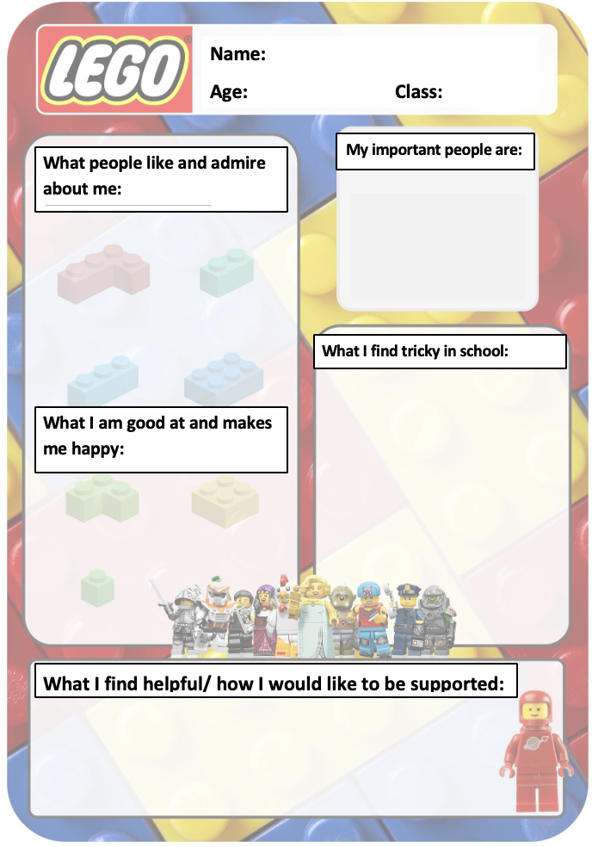
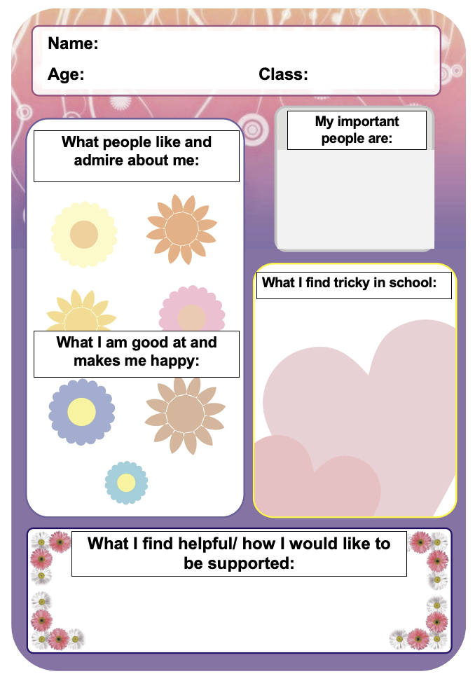
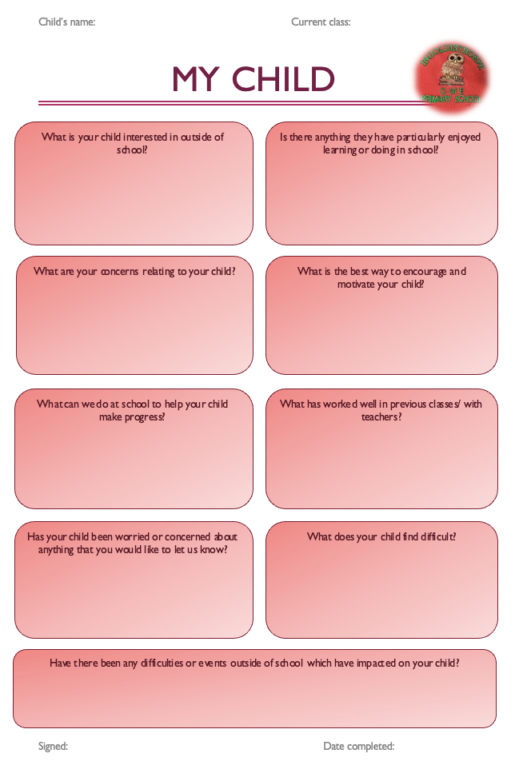
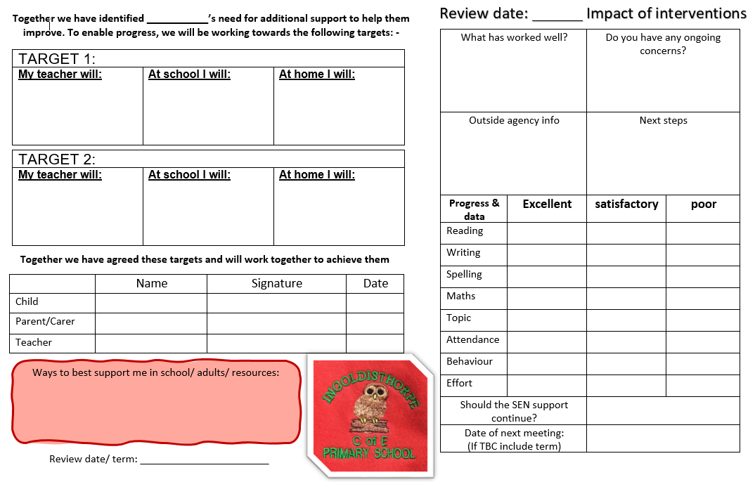
We believe pupil passports are a vital way to include children in their own provision, making sure they are a part of the process not having it placed upon them. They also help to foster a team around the child atmosphere of sharing between teachers, pupils and parents.
All information is kept securely and helps build a holistic picture of our learners with SEND.
CONTENTS
Adaptable bespoke pupil passports
Parent passports
Extended pupil passports

Slide 5
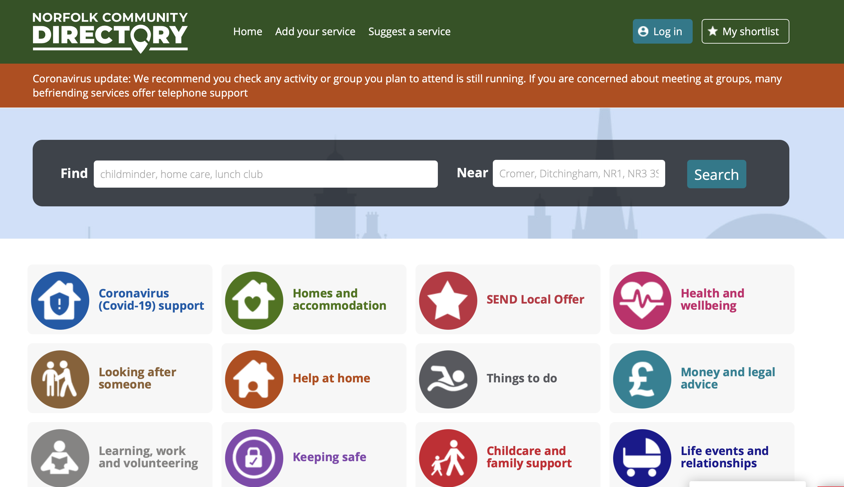
Local offer and SENDIASS
CONTENTS
Another useful website linked to the LA local offer is the Norfolk Community Directory, which contains activities, services and groups to help all of the community connect and lead active lives. It is a brilliant place for parents and children alike to research Norfolk based services and groups which could be beneficial. Click the picture to go to the directory or visit https://communitydirectory.norfolk.gov.uk
SENDIASS is a free and impartial service for parents and carers of children with different SEND needs. Based in Norwich and trained in SEND, they offer support, guidance, and confidential advice for those seeking it. This is a great place to find training, advice and resources to support families and learners, visit https://www.norfolksendiass.org.uk/ for more information.
Or call 01603 704070 or email
norfolksendiass@norfolk.gov.uk
The LA SEND local offer is available to all and intends to provide clear, comprehensive, accessible and up to date information about services in Norfolk and how to access them. The local offer is developed by the community for its users and is responsive to the needs of the pupils in its care. Click the picture to go to the local offer landing page or go to https://www.norfolk.gov.uk/children-and-families/send-local-offer

Slide 6
Teaching and the curriculum
CONTENTS
Teachers adapt the work or differentiate the learning and the delivery of lessons for all learners, especially those children with SEND. Enabling all children to make progress and achieve their full potential.
All pupils regardless of SEN are supported in their learning using a variety of interventions, differentiated work and learning style. Interventions, group work and 1:1 sessions are common practise across our school, with children and adults working collaboratively across all age groups. All classes have a visual or written timetable on each whiteboard which is discussed each morning for all children.
Through quality first teaching all learners with SEND are enabled to access the curriculum through;
Clear instructions supported by visual aids and key word prompts
Differentiated choice of work for all learners
Modified and extension materials
Range of groupings used including own choice groups, supportive groups, teacher led groups etc
Clear and concise expectations, visual where possible
Kinaesthetic activities to get hands on with learning
Technological aids such as computers, iPads, laptops, electronic readers, Dictaphones
Extra visual resources such as overlays, notes, recap sheets, spellings and multiplication grids
Dyslexia friendly texts, whiteboards and displays
Teachers and teaching assistants share the interventions to enable the children to have the best provision and expertise for each subject area. If you wish to discuss this with your class teacher, we have an open-door policy, they are available in the mornings before 9am and after school to talk to you. To arrange an appointment please email or call 01485 541402.

Slide 7
SEND awareness and Staff training
CONTENTS
At Ingoldisthorpe Primary School, we are passionate and committed to being a “family school where everyone matters.” As an inclusive school, SEND takes a high priority in our school and we all strive to ensure the best education for all.
To ensure widespread SEND knowledge and the best education for all in our school we;
Hold regular (twice yearly) whole staff SEND training sessions, (click here to see training log)
Specialist whole staff training including first aid, SLCN and Step-Up training
Thrive workshops to ensure high quality emotional wellbeing provision from our Thrive instructor
Hold staff workshops on different special needs areas including dyslexia, autism and separation anxiety
SENDCo holds regular core consultations and meetings with SALT, ASD and communities teams
Create whole school assemblies about differences, disabilities and equality linked to our British Values and our PSHE/ RSE learning
Teach the story of ‘The Prodigal Son’ (Luke 15:11-32) using its teachings to foster a feeling of acceptance, kindness and love in our school
Welcome visitors to our school who have a special educational need or disability
Hold regular time to talk sessions in each class to discuss different needs and differences in our lives, as we believe it is vital for children to learn about and understand special educational needs and disabilities

Slide 8
External agencies
CONTENTS
Where appropriate children may need to be referred to external services for advice, support and guidance to ensure the best provision for each child. Referrals are usually completed by the school SENDCo or by your GP. Our school SENDCo makes sure that good bonds are fostered between our school and external agencies to receive the best advice, support and informal help possible for our learners.
External support agencies we have used include:
Access Through Technology – (loaning technology to children who struggle to access the curriculum)
East Coast Community Health Care Speech and Language Team (ECCH provide assessments and SLCN work)
Nelsons Journey (supporting young people who have experience a significant bereavement in their young lives)
Norfolk Early Help (to support families in crisis or having difficulties)
Norfolk Educational Psychology Service (to assess and advise best practise for children struggling to access the curriculum)
Paediatricians
Links with the Church and our Reverend (surrounding bereavement)
Point 1 (Just One - mental health and well being support for children)
Mermaids UK (help for children who are struggling with their identity)
Occupational Therapists (advice and support for children who struggle with fine or gross motor skills)
School Nursing Team (supporting children with difficulties from bed wetting to emotional resilience to abuse)
Virtual School Sensory Support (supporting children with sensory needs to access schools)
Virtual school (supporting children from all different backgrounds to succeed in school)
Special school's links (working with special schools to improve our provision)
Reintegration into school team (helping those who have been out of school for extended periods)
These service are intended to help your child and your family to succeed. Most are voluntary and would be referred to with parental consent.

Slide 9
Assessments at Ingoldisthorpe
At Ingoldisthorpe Primary, we use assessments where necessary, to gain data about our learners and their progress. We may use a range of different assessments for different areas of learning. If you wish to discuss these assessments please contact your child’s teacher.
CONTENTS
Thrive assessments (social emotional and wellbeing)
Reception baseline assessments
Year 1 phonics tests
Hodder Reading tests, single word, sentence and speed read
Salford reading tests
Year 2 and 6 SAT tests (although all year groups have assessment weeks throughout the year)
Year 4 times tables tests
GL assessments
MaLT assessments for mathematics
Reading Now assessments
Sandwell early numeracy assessments
ECCH baseline assessments
Sound discovery assessments
Diagnostic Reading analysis
Graded Word spelling Vernon
NGRT assessments
Nellie speech and language assessments in EYFS
In areas where data is not easily available, feedback from teachers and TA’s will be given as assessment data.
Although assessments are key to tracking progress, all staff at Ingoldisthorpe are committed to ensuring a calm and relaxed approach to tests. Children should be aware but not worried about assessments.
We are proud of our attainment and our SEND learners successes.
95% of our SEND learners reached their end of KS2 expectations in 2023. 100% of our free school meals, PP and F6 children achieved there pass at KS2 SATS.
Within school, children and the interventions in place are monitored through provision maps. Each child has a provision map which shows the interventions, clubs, trips and visits they are accessing. To see a template provision map click here.

Slide 10
Provision mapping
CONTENTS
Provision maps enable each teacher to track the provision of all our learners with SEND and link them to the targets set for each child.

Slide 11
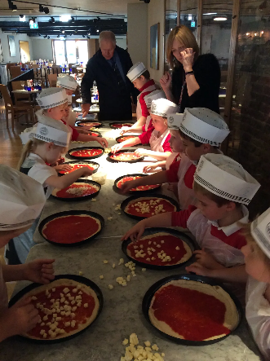
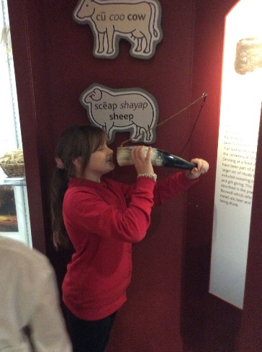
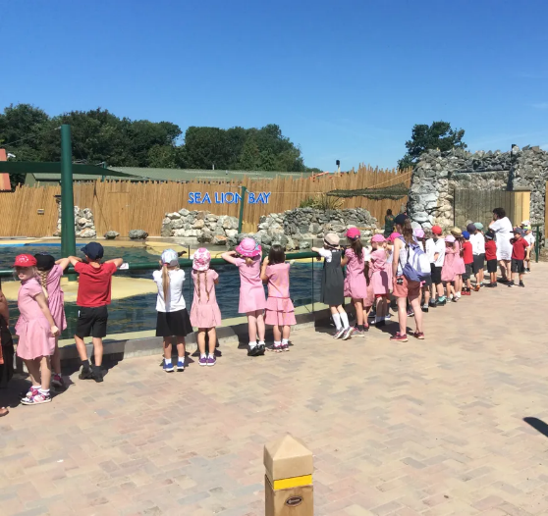
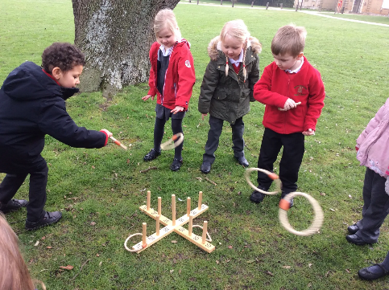
Trips, visits and events
CONTENTS
Our recent trips include:
Bircham Windmill
Holkham Hall
Banham Zoo
Bewilderwood
Gressenhall Farm and Workhouse
How Hill
Aylmerton Field studies centre
Our recent events include:
Sports evening
Harvest church service
Christmas Nativity
Music evening
Christmas Fayre
Mount Amelia (weekly)
Readathon days
Leavers show and services
As a fully inclusive school, all educational visits and extra curricular activities include all children in our setting. They are fully risk assessed and procedures are put in place to make sure all pupils can access the learning and experiences alongside their peers.
We are committed to making reasonable adjustments to include all pupils and with the help of parents have been able to successfully do this for all events and trips. If you have concerns about your child’s trip please contact your class teacher.
All pupils are welcome at after school clubs and wrap around care from 7.30am – 5pm.
Some pupils may need additional adult support and as such school will require notice for this provision.

Slide 12
Pupil and parent voice
CONTENTS
Where appropriate children will always be involved in decision making about their education. Children will be invited to all meetings with their parents to review their progress. We encourage children to set their own targets and to think carefully about the resources and provision which will best support their learning.
At Ingoldisthorpe Primary we place considerable value on the contribution of parents into the provision for their children as well as the wider school life. All staff are happy to answer questions from parents about all aspects of school life. Parents who express any concern are invited into school at the earliest opportunity to discuss their worries and find a common solution.
We believe that collaboration between staff and parents brings the best outcomes for our pupils. To ensure each child's development we work closely with parents to promote consistency, praise and a solid working relationship.
Children with severe need may have a home-school communication book for daily feedback or short morning/ afternoon check ins with parents to maintain open communication. Parents also help form working SMART targets, parent's passports and contribute to annual or termly reviews.
Children will also be able to complete a pupil passport all about them to find what their strengths and weaknesses are as well as what best works for them.

Slide 13
Transition (between classes and phases)
CONTENTS
Transition can be a difficult process for all children and after COVID and lockdowns, transition is a priority for the SMT at Ingoldisthorpe Primary. We have always made sure to carefully plan and think about transitions between classes, teachers, phases and between schools. At Ingoldisthorpe Primary we believe it is important for all children to meet their new teachers and get settled before the summer break, so we usually have a transition week. During this week, all children are able to find their feet in their new classes and get to know their new teacher. It is a fantastic time for all children, which reduces anxiety, worry and enables brilliant transition between classes.
To aid transition we will:
Have detailed discussions with previous or future settings and schools
Transfer reports and information to the new school
Make sure all children , whether in between classes or phases, will spend time in their new class or schools. Year 6 will spend a designated time in their new schools. This is determined by the high schools and varies from 3 days to 1 week in the summer term.
Apply for additional time and visits to be arranged at new settings (depending on the setting and need) for those with SEND. Our SENDCo will liaise with parents and the new school to arrange this where possible or necessary.
Where specific needs must be considered a special meeting can be arranged involving our SENDCo, the new SENDCo, class teachers new and old, parents and if appropriate the child.

Slide 14
Roles and responsibilities
All staff and governors are expected to attend training and offer feedback about the school provision. SENDCo should deliver staff training as well as head teacher.
CONTENTS
Class teacher
Responsible for checking and monitoring progress of the children in the class, differentiating and adapting lessons to needs of the class, writing and reviewing targets, communicating regularly with parents of SEND pupils, working with other staff to provide best education for all pupils, attend meetings and annual reviews, being mindful of children with SEND and ensuring that school policies are read, understood and adhered to.
Teaching assistants
Responsible for supporting students access the curriculum, empower students, use Thrive techniques to help regulation of pupils, observe and record concerns, keep student focused and deliver small group or 1:1 interventions in conjunction with teachers.
Governors
Responsible for making sure the appropriate support is in place for any child with SEND at our school, where necessary meeting with governors, SENDCo, head to discuss provision and to evaluate the effectiveness of the provision.
SENDCo
Responsible for raising awareness of SEND in the school, ensuring provision is agreed and occurs at appropriate time and pace, coordinating support, monitoring progress, liaising with external agencies, keeping records, supporting children, parents and staff, liaising with other schools and providers, developing SEND policy, writing termly SEND reports for the governors and for staff meetings, running staff training and awareness sessions, updating policies and reports, communicating with parents regularly, answering queries and attending meetings. SENDCos should also be keeping up to date with current guidance, changes and updates to the local offer.
Head teacher
Responsible for managing the day to day running of the school, maintaining support for SEND learners, ensuring that children's needs are met with the best provision, ensuring quality first teaching and teaching standards, keeping the governing board up to date and informed about the SEND learning and provision of the school. Although some of this is delegated the headteacher is still responsible for the educational provision of all children. Our head teacher also takes an active role with parents, meetings and with safeguarding all of our children.
To see our recent training log for all staff and stakeholder click here

Slide 15
Recent training
CONTENTS
NASENCo training 2020-2021
Safeguarding whole school training September 2022
Chairing annual reviews, and supporting transition AT October 2022
Attendance support SW November 2022
Designated safeguarding lead training update November 2022
Family support process training November 2020
Safeguarding training SW December 2022
NELI training for 4 staff in YR, speech and language support in reception 2022
Transition for EAL pupils from Ukraine training September 2022
Whole staff (x12 staff) first aid at work training January 2023
Paediatric first aid training (x4 staff) January 2023
Glue ear training LD April 2023
Thrive – update training June onwards 2023
Whole school training SEND September 2023 with a focus on dyslexia, ASD and EBSA
EAL training for two specialist staff September November 2023
Core consultations and meetings with NCC and SENDCo every year termly
Supporting EAL learners in the classroom JH November 2023
Epep training for staff using the programme November 2023
PLANNED TRAINING
INSET training January 2024 focusing on SEND interventions and reading skills
Whole school inset on ADHD and how to support our learners Spring term 2024
NPQH training AT
Epep update and training AG
Thrive updates Summer term AT
All of this training is cascaded through the school through staff insets, governor minutes, meetings and through handouts given to all staff, where appropriate.

Slide 16
EHCP (Educational Health Care Plan)
CONTENTS
https://www.norfolk.gov.uk/children-and-families/send-local-offer/education-and-learning/support-for-learning/education-health-and-care-ehc-plans/ehc-needs-assessment-and-plans/ehc-needs-assessment-requests
Most learners with SEND will have their needs met in school and in the classroom, however some may require an Education, Health and Care needs assessment to determine whether it is necessary for the Local Authority to make additional provision (that cannot be met within the current setting) with an Education, Health and Care Plan (EHCP). The school and SENDCo will provide the LA with all relevant reports, feedback and forms to help the process move forward, making sure to keep parents up to date and keep open lines of communication.
As of September 2014, all children on a statements were issued an EHCP. Under that guidance, all parents have the right to request the Local Authority conduct an EHC assessment. This process can take up to 24 months, in some cases less and in some substantially more.
Where a child has an Education, Health and Care Plan (EHCP), there will be an annual review meeting held in addition to the termly review meetings, finding the views of the child, their parent or carer, and all other professionals involved with the child. This meeting will often involve the EHCP coordinator, EHCP writers, social care, teachers, parents, therapists, specialists and most importantly the child (where appropriate.) Parents have the right to call a review meeting whenever they feel is necessary. Personal budgets for OT and SLCN work can also be applied for.

Slide 17
Index of acronyms and language
CONTENTS
Differentiation: adapting the classwork to meet the needs of all learners, often in our school we have 3 levels of work for the children to choose to complete ranging from emerging to greater depth level work. All children should be able to access the work and have it at a level suitable for them. In some cases work will be enlarged, reprinted or created uniquely for the child and the need.
SENDCo – the special educational needs and disabilities co-ordinator
SEND – special educational need and disability
LA – Local authority – Norfolk SEND department is our local authority
OT – Occupational therapy/ therapist
EHCP – Educational Health Care Plan – LA plan to provide education not currently provided by current setting
APDR – assess, plan, do, review is a process used to set targets and measure the progress of children with a SEND
Interventions – a variety of planned programmes put in place to help bridge the gap in learning for all our children with SEND
Monitoring list – a list created by school of children who may have a difficulty and need to be monitored. This does not necessarily mean the child will be placed on the SEN register but needs additional support. Often children are removed from the monitoring list after interventions and in class support have helped to increase progress, achievement and confidence.
SEN register – a list of children with SEND for the school to monitor closely and ensure progress is being made, including bespoke individualised curriculums, interventions and regular meetings with parents. Parents must consent to their child being named on the SEN register.
SLCN – Speech, Language and communication needs, this refers to children with difficulty speaking, understanding and communicating.
SEMH – Social, emotional and mental health needs, this refers to a child ability to manage and regulate their emotions on a daily and situational basis.
SRB – Special resources base – a school which has a specific area dedicated to specialist provision for children, ranging from behavioural units to speech and language bases. SRB’s are brilliant for helping children thrive and learn in specific targeted areas.

Slide 18
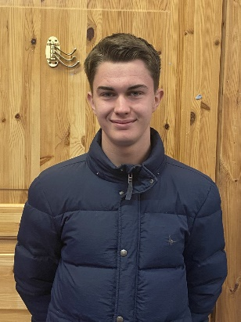
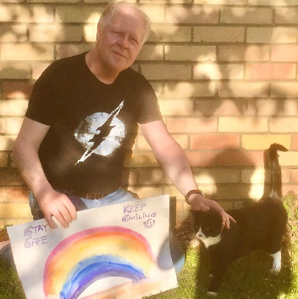
Contacts
If you wish to discuss your child’s progress or a possible SEND provision, please firstly contact your child’s class teacher by phone or email during the school week 8am-5pm.
School telephone: 01485 541 402
Acorn class- Mrs Howarth Hazel class – Mrs Dickinson/ Mr Hazel Willow class – Mrs MacGowan
acorn@ingoldisthorpe.norfolk.sch.uk hazel@ingoldisthorpe.norfolk.sch.uk willow@ingoldisthorpe.norfolk.sch.uk
Maple class – Mr Gachowicz Oak class/SENDCo – Mrs Taylor
maple@ingoldisthorpe.norfolk.sch.uk oak@ingoldisthorpe.norfolk.sch.uk
CONTENTS
Reception
Year 1
Year 2
Should you need further help or advice please contact Mrs Taylor, our school SENDCo via email or our head teacher, Mr Wright via email at head@Ingoldisthorpe.norfolk.sch.uk
If you wish to make a complaint please click here to view and download our school complaint policy.
Year 3/4
Year 5/6
Mrs Taylor received her NASENCo award in 2021 and has been Thrive trained for over 5 years. She has been a teacher for 12 years with a BA(Hons) 1st class.
FAQ’S

Slide 19
Frequently asked questions - 1
CONTENTS
How does the school know when a pupil has a learning need or difficulty?
We know pupils need additional help when a concern is raised by a teacher or parent, if limited or no progress is being made or if there is a change is the pupils’ behaviour or pace of progress.
What should I do if I think my child has special educational needs?
Speak to your child’s class teacher via the contact page, if you still feel you need more support contact the school SENCo (Mrs Taylor) or the headteacher.
How is the curriculum matched to my child’s needs?
All class work is differentiated for all learners whether they be high attaining children or those who are lacking in confidence, there is work for all pupils. If a child is identified as having a SEN, there work will be further adapted to enable them to access the curriculum better. TA’s may be allocated for intervention or short bursts of 1:1 support. Children will be given a pupil passport and all staff will be aware of the best ways to help that child. Targets will be set which all staff will work towards, some targets involve using specialist equipment such as slopes, cushions, weighted blankets, pencil grips, special scissors, fidget toys etc. Some children with very complex needs may have an individualised personal curriculum developed by parents, teachers, TA’s, specialists, SENDCo’s and pupils, this curriculum ensures their needs are met.
How does the school support pupils transfer to and from the school?
At Ingoldisthorpe Primary School we work exceptionally hard to ensure that any transition goes smoothly for all our learners. Discussion between previous or future schools will take place to keep communication open about the needs of the child. All reports and information will be transferred. All children will have the opportunity to spend time with their new class and teacher in transition time – the length of this will depend on the schools. Additional time and visits can be arranged if needed. SENDCo’s will be in good communication to make sure that all information is passed on and that the transition is seamless.
More FAQs
Back
to contacts

Slide 20
Frequently asked questions - 2
CONTENTS
How is support organised for pupils with SEN? How does the school monitor the progress and impact of the SEN support?
Each child with SEND will have an individualised curriculum and planned differentiation by the teachers in their class. If a pupil needs extra help in specific areas of the curriculum such as spelling, phonics, reading, maths, memory etc. then the pupil will be placed in small focused groups run by teachers and teaching assistants. The length of the intervention will average 15 minutes per session and will usually continue for a minimum of 12 weeks or 1 term. The interventions will be regularly monitored using assessments, baselines and observations. On occasion a child may need additional support from a specialist – a referral can be made, advice can be received and utilised. Children may also require specialist equipment such as slopes, grips, laptops, computers, overlays or resources and these can be provided on a needs basis.
How are decisions made about the amount of support my child will get?
Decisions are made in consultation with the class teacher, teaching assistants, parents, pupils, SENDCo and senior leadership. They are based upon termly tracking and concerns and as a result of assessments made by outside agencies. During school time, if concerns are identified due to lack of progress or well-being of the child, interventions will be arranged or adapted at the earliest point possible.
How does the school involve parents and carers in the planning process and target setting?
All parents are regularly contacted by teachers and the SENDCo and are actively encouraged to contribute to their child's education. This will be through conversations at parents evenings, discussions with the SMT and SENDCo, parent passports, review meetings and through communication books (where appropriate).
What expertise and training do staff have?
Throughout the school, all staff are regularly trained on safeguarding, SEND and additional training such as first aid which can benefit our SEND learners. On our staff we have adults who are trained in Thrive, sign language, physical and coordination needs support, Sound Discovery, Read ‘n’ Write, Occupational Therapy strategies, Speech and language strategies as well as regular teacher training to provide top up training across many areas of SEND.
For more information on recent training please see our training page.

