Slide 1
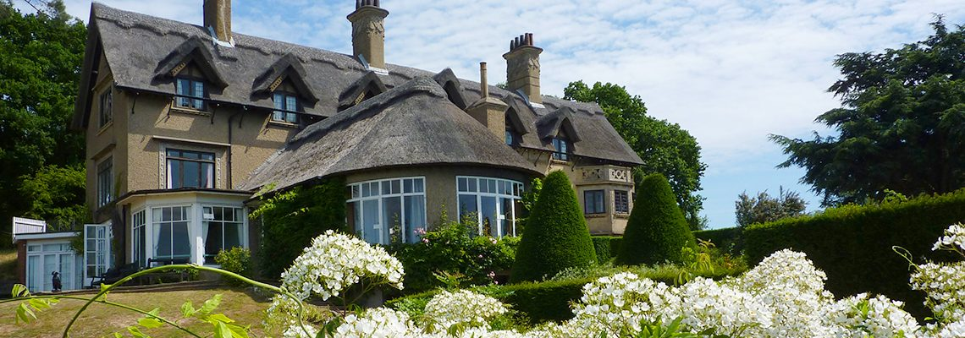
How Hill Trust The Environmental Study Centre for the Norfolk Broads

Slide 2
When is it? Wednesday 7th February – Friday 9th February 2024

Slide 3
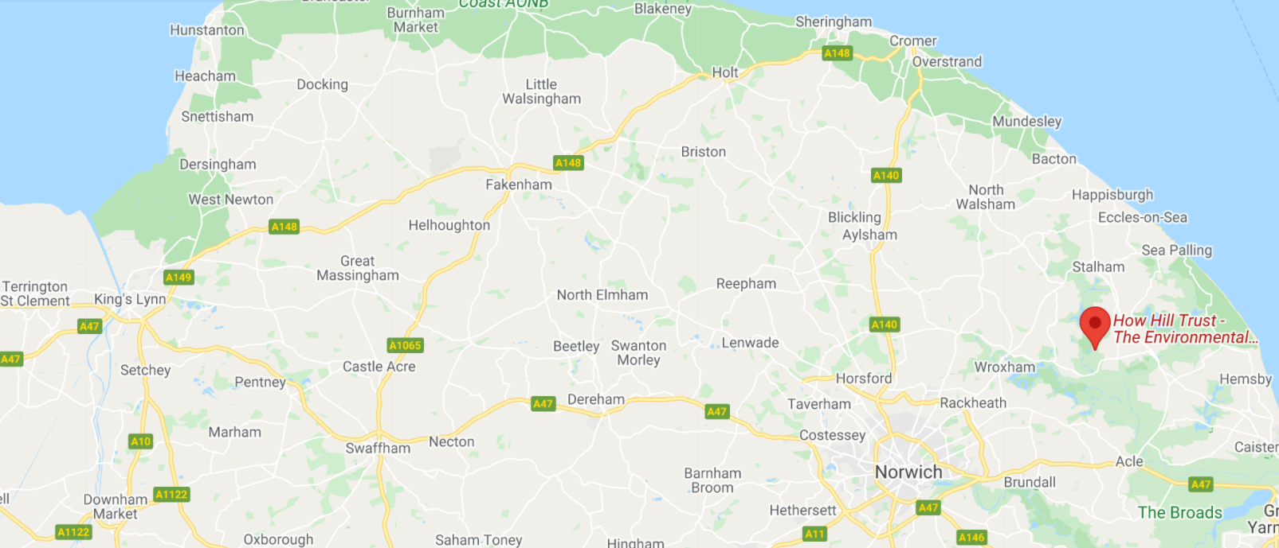
Where is it?
How Hill Trust, Ludham, Great Yarmouth, NR29 5PG 1hr20mins drive

Slide 4
How Hill Education
How Hill has been awarded the ‘Learning Outside the Classroom’ quality badge – which combines learning and safety into an accreditation scheme, making it easier for staff to take students on educational visits.
All our activities are linked to the national curriculum – science, English, OAA/PE, PSHE, History, Geography, Art & DT

Slide 5
What do they offer?
All activities take place on site. During your stay you would have exclusive use of our beautiful house and all our excellent facilities. Our kitchen team will provide delicious homemade meals for you and will do their best to accommodate all dietary requirements.
Great benefit to children’s wellbeing; it can boost confidence, build resilience.
Whole building to ourselves.

Slide 6
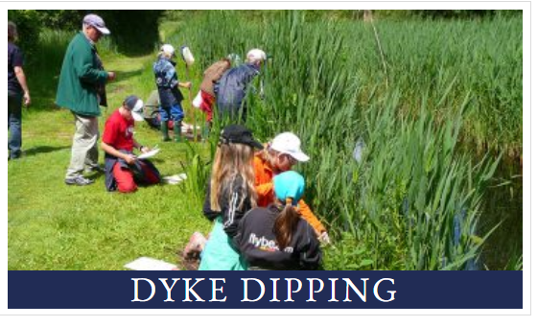
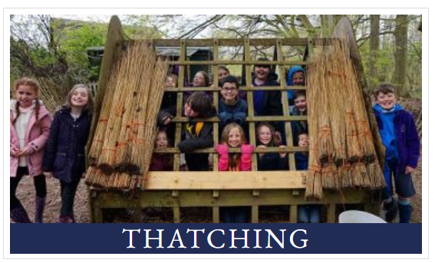

Slide 7
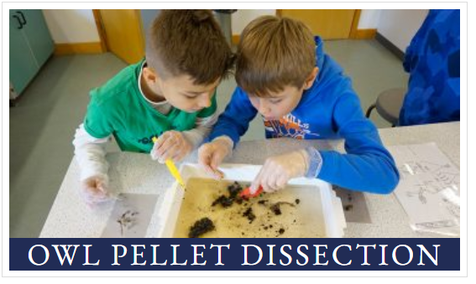

Slide 8
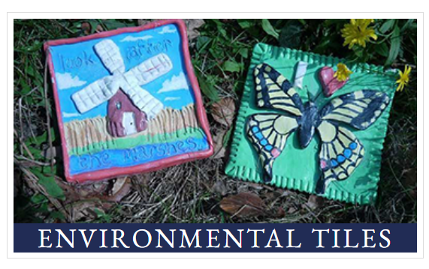

Slide 9
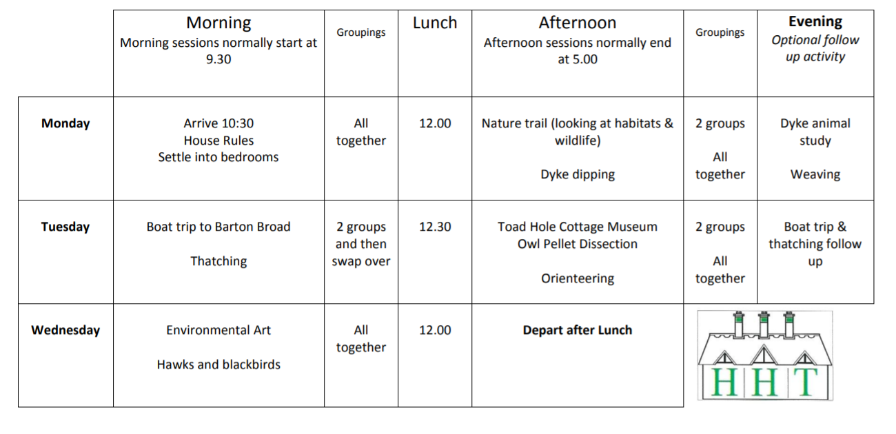
Timetable Sample

Slide 10
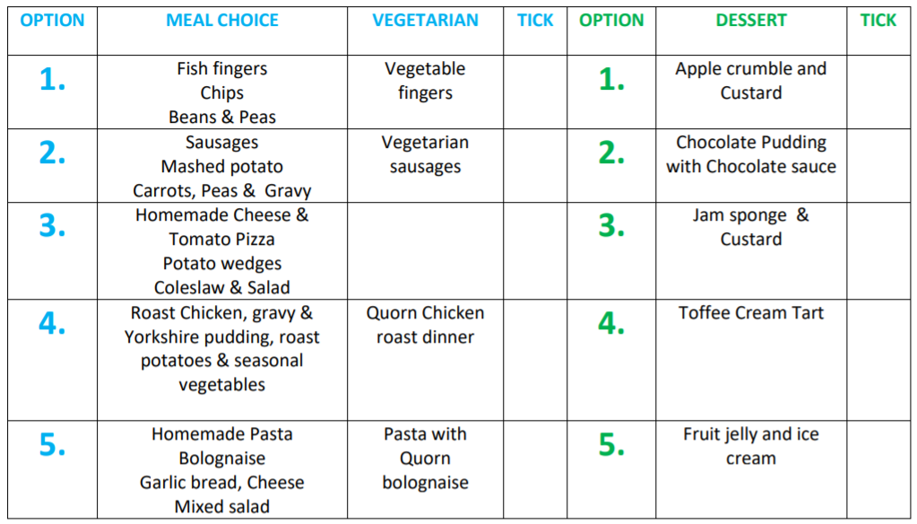
Food

Slide 11
What are the rooms like?
There are 13 bedrooms arranged over two floors. All are warm and clean, with en-suite bathrooms. Many rooms are dormitory style with several beds, but there are no bunk beds.
Children will choose up to 3 children to share a room with.
Boys and girls separate.

Slide 12
What happens in the evening?
Teachers are provided with optional worksheets to complement the day’s activities; materials for weaving; and sports equipment. Footage from the camera traps can be viewed on the communal TV and DVD player. Some schools choose to hold a talent contest, evening walk or disco.
Teachers will be available all night if needed to comfort children

Slide 13
What to take? Suggested kit list for school residential visit
Sleeping bag, single sheet, pillow
Towels and toiletries
Wellingtons, Slippers or indoor shoes Outdoor shoes/boots
Waterproofs, coats and trousers - How Hill does have many spare trousers and coats
Plenty of socks, in particular thick socks for wearing with wellingtons
Sun cream, insect repellent and hat (summer) Gloves, scarf and hat (winter)
Warm clothes - plenty of layers At least two pairs of old trousers
Spending money - How Hill has a small shop selling souvenirs
A cuddly toy to sleep with!
PLEASE SEND CHILDREN WITH CLOTHES THAT CAN GET DIRTY AND MUDDY
No electronics, food or drink or other personal items which could be lost or damaged

Slide 14
Video
https://youtu.be/KbJzHhsIxwQ

Slide 15
Questions?

Slide 16
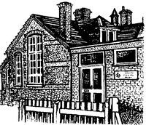
Ingoldisthorpe C of E Primary School
How Hill Residential Trip 7th-9th February 2024
________________________
Maple Class

